Slide 1

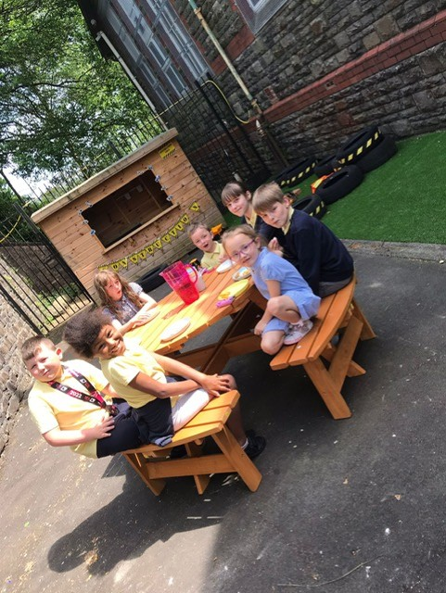
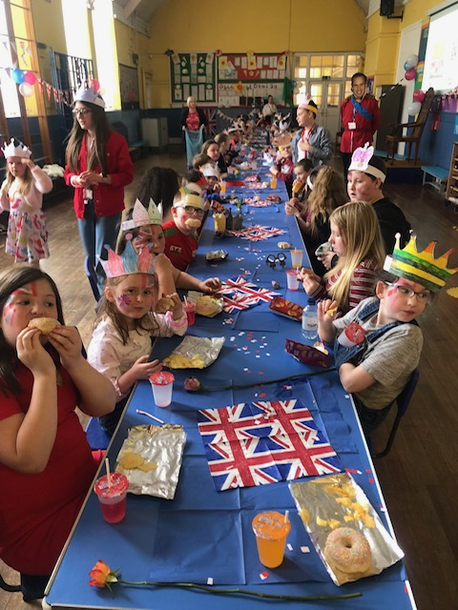
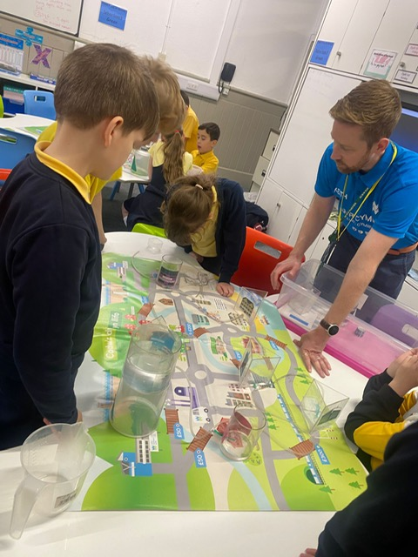
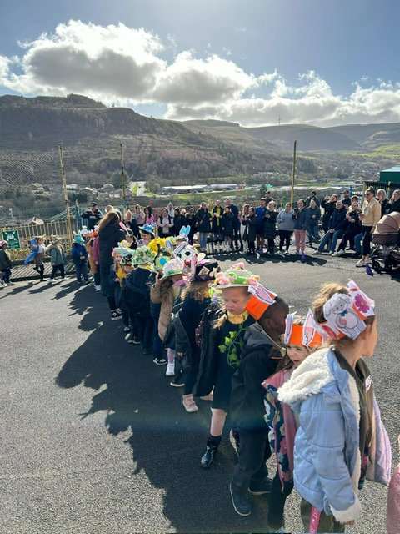
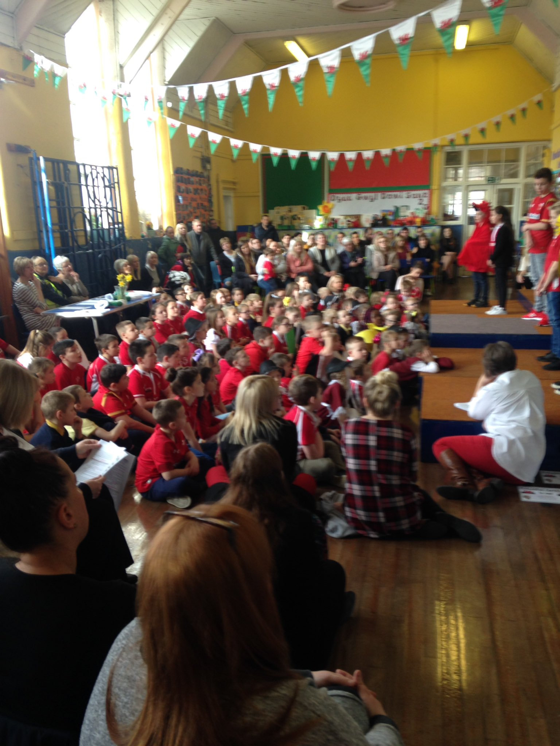
Prospectus
2023- 2024
Bodringallt Primary School
Be the best you can be
Bodringallt Primary School
Ysgol Gynradd Bodringallt
‘Be the best you can be’

Slide 2
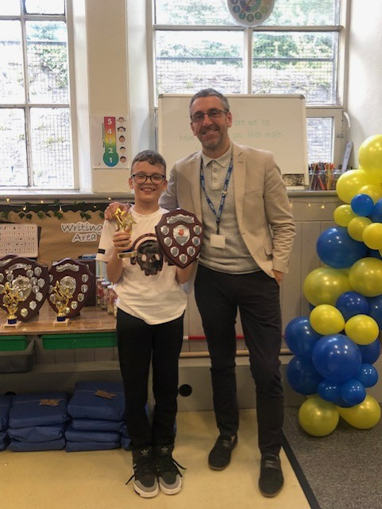
Bodringallt Primary School
Bodringallt Terrace,
Ystrad,
Rhondda,
CF41 7QE.
Tel No: 01443 434292
Email: Admin@bodringalltprimary.rctcbc.cymru
Be the best you can be
Croeso,
I am delighted that you are considering sending your child to Bodringallt Primary School. You, like us, also want them to be happy, feel safe and secure and be the best they can be. Our school motto is ‘be the best you can be’ and our school offers a diverse range of opportunities for its pupils.
We are committed to this vision and our experienced staff are dedicated to delivering a curriculum that is full of authentic, engaging experiences to ensure that our children can develop and acquire the skills and knowledge they need to become lifelong learners and informed citizens.
We believe in unconditional love for the children, nurture underpins all our approaches and we are a restorative school, as we believe every child should be heard and we want all of our learners to have the correct skills in order to repair relationships with one another. Relational aspects with our community are the most important, based on love, trust and mutual respect. Our inclusive and supportive ethos guarantees that all children settle in well and our experienced ALNCo ensures that our children have the right level of support in order to flourish. As well as classroom staff, our family engagement officer is also available to provide key support and direction to our pupils and their families. Our clerk is here to help with issues also.
Parents/carers are always welcome in our beautiful school. Please do not hesitate to contact me on any aspect relating to this prospectus or any other matter pertaining to the education and well being of your child at Bodringallt Primary School.
Bodringallt Primary School is a very happy, loving and welcoming place to be and we are extremely privileged to serve the children, their families, the school and our community. We look forward to meeting you and working in partnership to give your child the very best school experience.
Throughout this prospectus we hope to paint a picture of life here at Bodringallt Primary School. It is impossible to capture the spirit and atmosphere of our school in words and a visit is the best way to experience our beautiful school. With this in mind, we look forward to seeing you and having a cuppa after looking at our wonderful school.
Diolch,
Mr S Howells

Slide 3
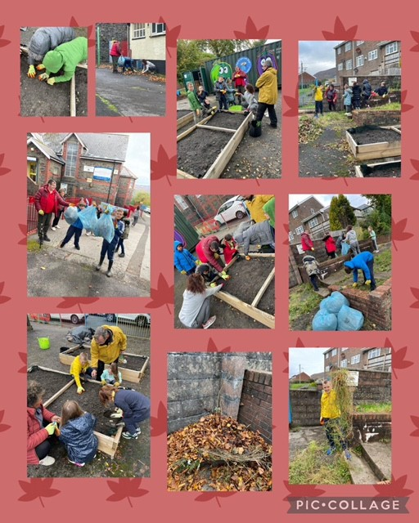
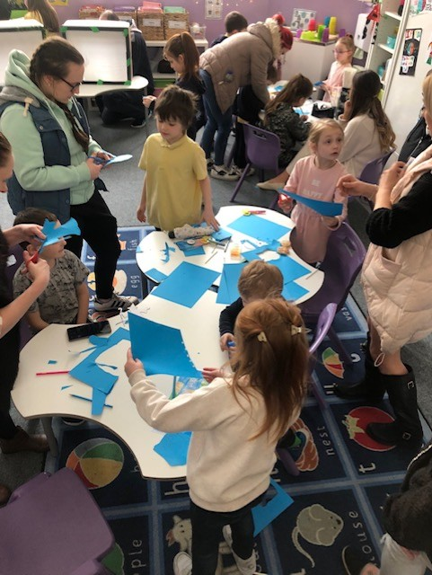
Our School Vision
At Bodringallt Primary School, we believe that every family is as an integral part of our school community, the Bodringallt Family.​
​
Through unconditional love, we have always prided ourselves on creating a nurturing and safe environment in which our children are happy, are challenged to grow as persevering, confident and unique individuals showing readiness to become empathic citizens and lifelong learners.
We develop our learners to be both physically healthy and emotionally secure, through embedded trauma informed practices and our whole school approach to wellbeing.
We encourage aspiration, opportunity and optimism by celebrating each child, their ambition, whilst remembering that every child is precious and unique; in order to enable them and us ‘to be the best we can be’.
​For us, success means that our children feel happy, loved and safe that they have confidence and belief in reaching their full potential, whilst always showing respect, kindness and honesty, valuing and understanding the differences across Wales and the world.
Be the best you can be

Slide 4
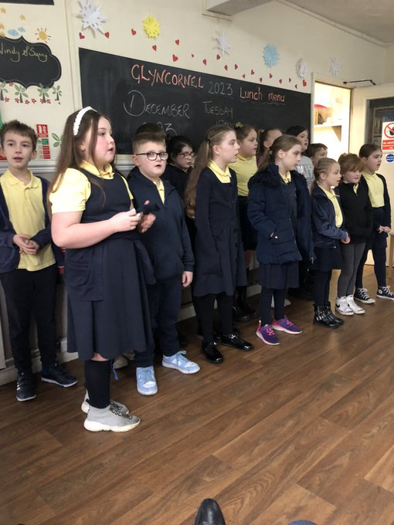
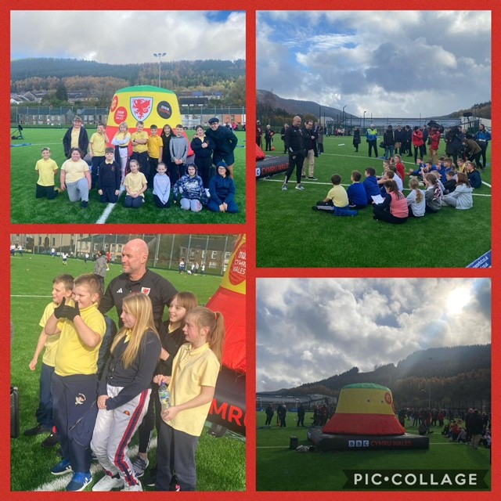
Introduction
Bodringallt Primary School is an English Medium school, situated in Ystrad Rhondda, in the Rhondda Valley, South Wales. It has served the children of Ystrad and beyond since 1869. The school currently has four classes, including a Local Authority Social Emotional and Behavioural Difficulties (SEBD) Class. There are currently 87 full time pupils on roll, ranging from 3 to 11 years old.
The staff, pupils, community partners and ‘Parents and Friends’ group of Bodringallt Primary School benefit from large buildings, community and school gardens and grounds with lots of space. As well as our four classrooms we have two halls, learning areas in our upstairs hall, our ‘Rainbow’ provision (in house nurture provision – 15 years and going strong), our ‘Bod Pod’ and our family room too.
We have very strong links with the local community and work regularly with Dig 4 Health, Save the Children, Treorchy Male Voice Choir, Pobl y Gwaith, Cambrian Village Trust, Sporting Marvels, Big Bocs Bwyd, Central South Consortia and Valleys Kids amongst many others.
One of the biggest strengths of the school is our nurturing ethos and the unconditional love we give; we have several ‘Thrive’ trained staff, pursuing Nurturing Schools Status and our staff are actively engaged in curriculum and professional networks, developing their and our practice through much self directed research. We are innovative in our approach and are always seeking ways in which we can improve and provide the best possible experiences for the learners in our care.
Despite, extreme funding cuts over the last few years, other strengths of the school include music and extra-curricular opportunities. We have an extremely active choir who take part in concerts both in school, nursing homes, chapels, churches, the old age centre and other venues near and far. We have provided several clubs from Year 1 – 6 – ranging from Fun Club, Cambrian Club, Dance Club, Empathy Club, Coding and Cookery too. Pupils get the benefit of school clubs, attending cluster events and we have coaching in school from Cricket Wales, Cambrian Village Trust and Sporting Marvels amongst others.
Enquires about admissions can be made directly to the school or through Rhondda Cynon Taff Council.

Slide 5
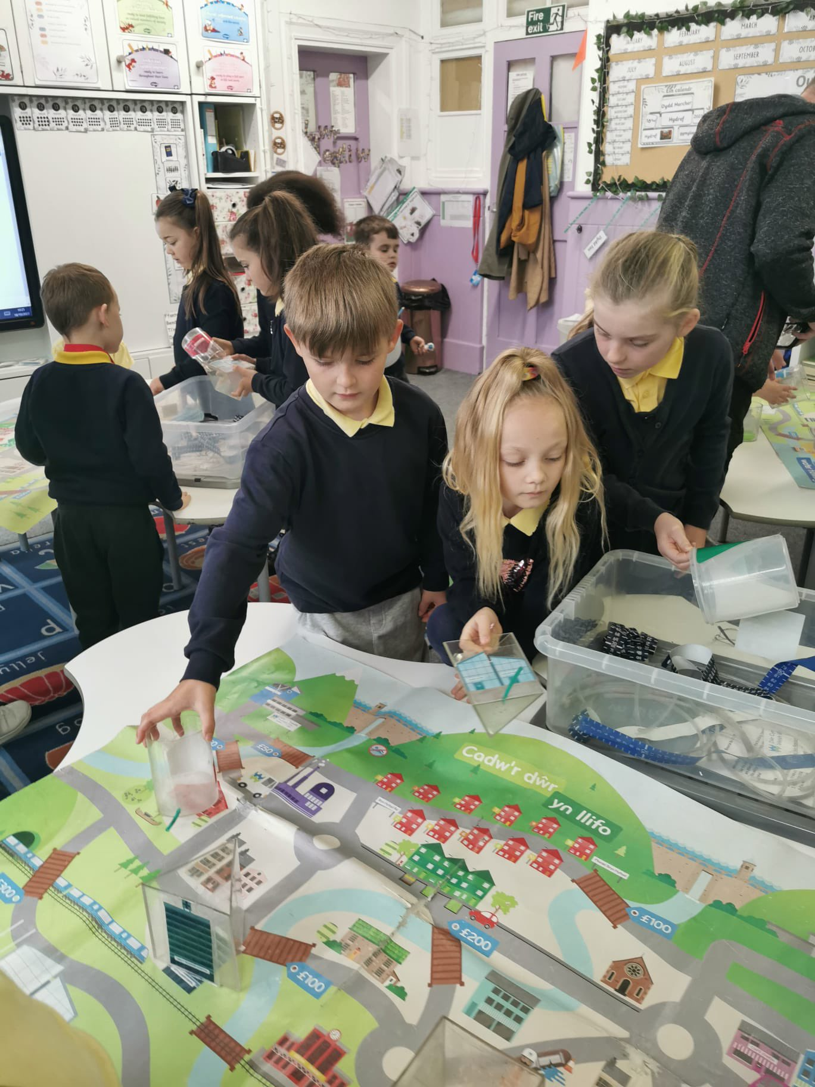
Aims of Bodringallt Primary School
At Bodringallt Primary School we believe that each and every child is special and unique. We strive to enable them to be the best they can be and provide opportunities for happiness and success for every one of them, while providing a high standard of education and provision.
Aims and Objectives
Nurture and support emotional wellbeing, where relationships with children, their families and the wider community are at it’s heart
Love and support our children so that they discover the means of developing their unique personalities for them to reach their potential, develop acceptance, empathy, independence, resilience, and gain the skills, attitudes and knowledge that will meet their future needs – to walk shoulder to shoulder with anyone, anywhere, when they leave the Bodringallt Family
Create a flexible and responsive environment – to the needs of ever changing learner needs and cohorts
Provide calm neutral and natural learning spaces that provide comfort, areas for exploration / writing / mark-making / reading areas with high / low tables chairs, cushions
Enable our children to be literate, numerate and at ease with technology
Uphold high expectations of all children’s learning
To have high expectations of all children’s behaviour
Cultivate, maintain and value strong partnerships between staff, children, parents/carers and the local community, our partners and industry
Foster a climate of success by celebrating achievements both inside and outside school in ways that uplifts the children
Promote spiritual and moral development of children, preparing them for adult life
Instill a sense of pride in our locality, our nation, our language and our heritage, whilst being aware of, and respectful towards other communities

Slide 6
School Staff
Headteacher | Mr S Howells
Deputy Headteacher | Mrs E Gooch
Additional Learning Needs Coordinator - ALNCO | Mrs E Gooch
Classes | Year Groups | Progression Steps | Teachers | Teaching Assistants
Dosbarth Cubs | Nurs/Recep/Yr1 | 1 | Mrs R Green (PT) Miss Hughes (PT) | Miss L Bull (FT) Miss J Jones (PT) Miss N Yates (PT) Mrs V Adams (PT)
Dosbarth Wiwer | Yrs 2/3/4 | 2 + 3 | Mrs S Zobole (PT) Mrs S Williams (PT) | Mr L Grenter (PT) Miss L Fisher (PT)
Dosbarth Gwdihw | Yrs 5/6 | 3 | Mrs E Gooch (FT) Mrs N Bhaheeram (PT)
*Dosbarth Llwynog – LA Designated Class for SEBD | Yrs 3/4/5/6 | 2 + 3 | Mrs L Matthews (FT) | Miss S Stoddart (FT) Miss S Jones (FT)
Music Teacher (Mondays PM) | All | 1+2+3 | Mr H Evans (PT)
Family Engagement Officer (FEO) + Rainbow | Mrs H Howells (PT)
Clerk | Mrs B Edwards
Caretaker | Mr W Dury
School Cook | Miss J Everett
Kitchen Assistant | Mrs H Davies
Dinner Supervisor | Mrs H Brabon
Breakfast Club Lead | Miss J Everett
Breakfast Club Assistant | Mrs H Davies
Full Time Equivalent (FTE) Teachers | Full Time Teaching Assistants - Mainstream | Full Time Teaching Assistants – SEBD Class | Part Time Teaching Assistants - Mainstream | Part Time FEO
4 | 1 | 2 | 4 | 1

Slide 7
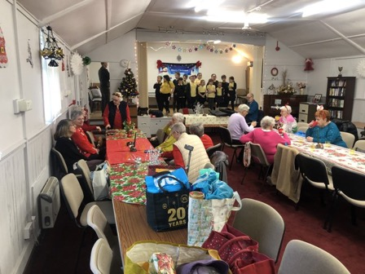
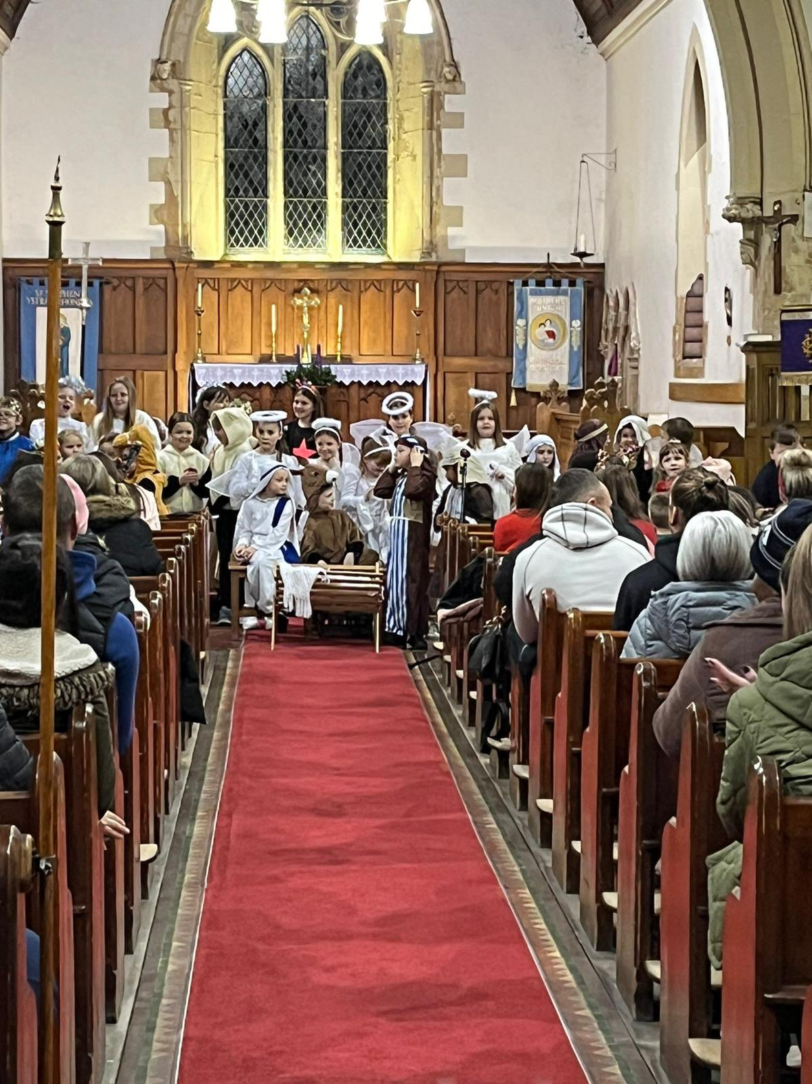
Bodringallt Primary School
Governing Body 2023/ 2024
Name | Designation
Mr S Howells | Head Teacher
Mrs L Llewellyn | Chair of Governors / LA
Mrs E Dunning | Vice Chair of Governors / LA
Mr G Jones | Local Authority (LA)
Mrs R Saunders | Community Governor
Mrs R Mellor | Community Governor
Mrs S Zobole | Teacher Governor
Mrs B Edwards | Non Teacher Governor
Mrs E Lloyd | Parent Governor
Ms J Gore | Parent Governor
Miss Ly Evans | Parent Governor
Miss L Evans | Parent Governor
Vacant | Community Governor
The governors at Bodringallt Primary are individuals who accept responsibilities for the actions of the school. They are parents, staff or representatives of the local community who care about the teaching, learning and most importantly of all, the children. Governors act as a link between parents, the local community and the school. They play the role of a critical friend, who support the school, but monitor how the school works and the standards that it achieves.
Our Governors are hardworking and committed to the children and the future of the school. They take a very active part in school life, we could not do without them. They are very happy to be approached by parents with ideas, suggestions and concerns.

Slide 8
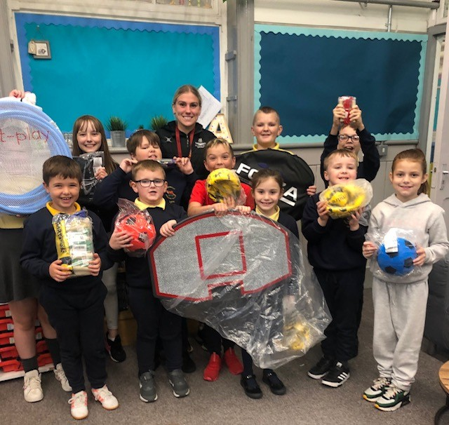
Bodringallt Primary School
Term Dates 2023/ 2024
Term | From | To
Autumn 2024 | Monday, September 2 2024 | Friday, October 25 2024
Half Term | Monday, October 28 2024 | Friday, November 1 2024
Autumn 2024 | Monday, November 4 2024 | Friday, December 20 2024
Christmas Holidays | Monday, December 23 2024 | Friday, January 3 2025
Spring 2025 | Monday, January 6 2025 | Friday, February 21 2025
Half Term | Monday, February 24 2025 | Friday, February 28 2025
Spring 2025 | Monday, March 3 2025 | Friday, April 11 2025
Easter Holidays | Monday, April 14 2025 | Friday, April 25 2025
Summer 2025 | Monday, April 28 2025 | Friday, May 23 2025
Half term | Monday, May 26 2025 | Friday, May 30 2025
Summer 2025 | Monday, June 2 2025 | Monday, July 21 2025

Slide 9
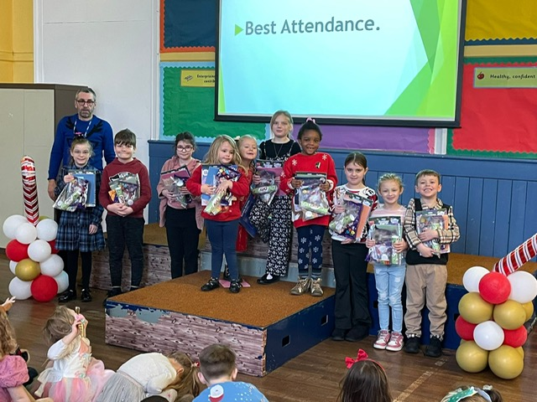
The School Day
School hours are as follows:
AM - morning session
8:55 – 11:45 (Nursery) 12:00 (Reception+Year 1) - Dosbarth Cubs (Nursery, Reception + Yr1)
8:55 – 12:00 Dosbarth Wiwer (Years 2,3 + 4)
8:55 - 12:00 Dosbarth Gwdihw (Years 5 + 6)
8:55 – 12:00 Dosbarth Llwynog (LA Designated SEBD Class Years 3-6)
PM - afternoon session
1:05 – 3:15 Dosbarth Cubs (Nursery, Reception + Yr1)
1:05 – 3:20 Dosbarth Wiwer (Years 2,3 + 4)
1:05 – 3:20 Dosbarth Gwdihw (Years 5 + 6)
1:05 – 3:30 Dosbarth Llwynog (LA Designated Class Years 3-6)
Progression Step 1 and 2 children must always be collected by a responsible adult known to staff. If this is not the adult who usually collects them then the class teacher must be informed in advance.
Progression Step 3 children (Years 4-6) are permitted to walk home unless parents request otherwise.
If you are unable to collect your child for any reason or are likely to be late, please telephone the school.

Slide 10
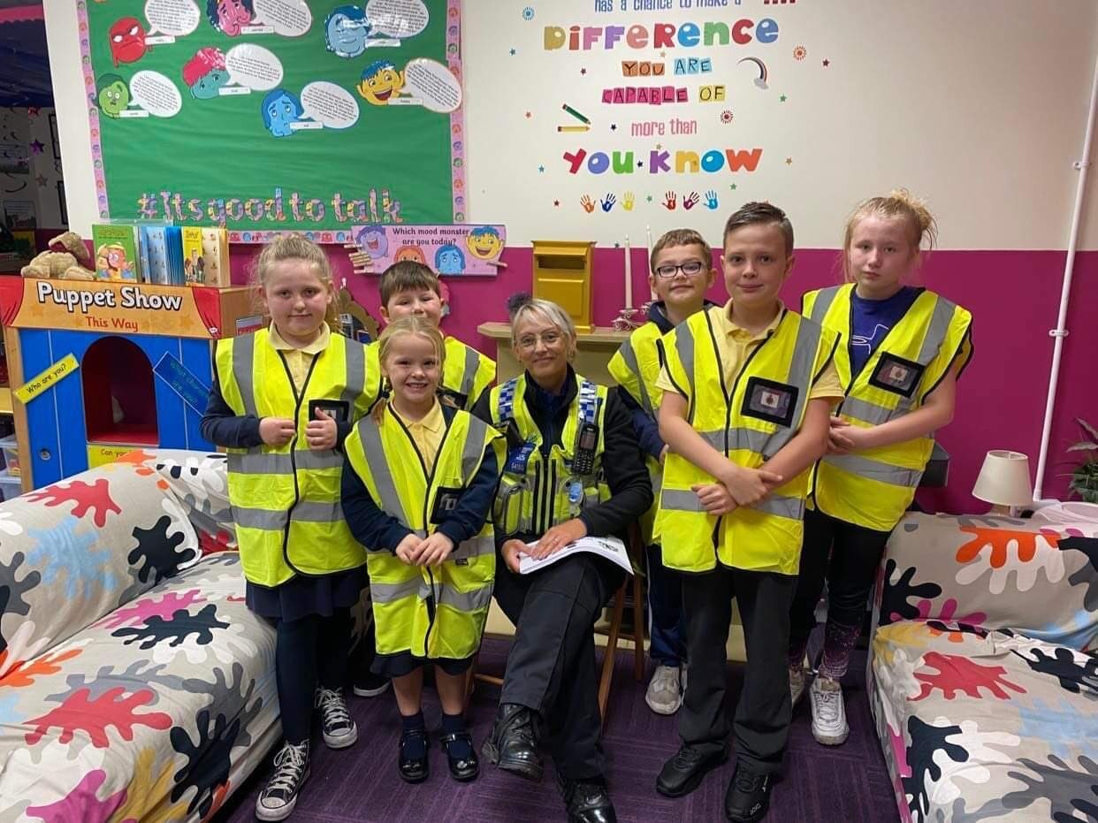
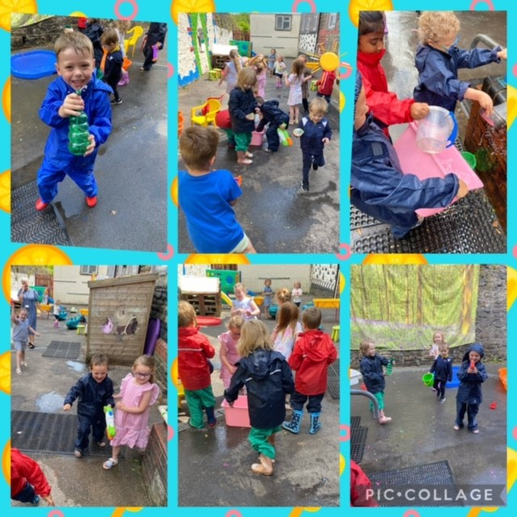
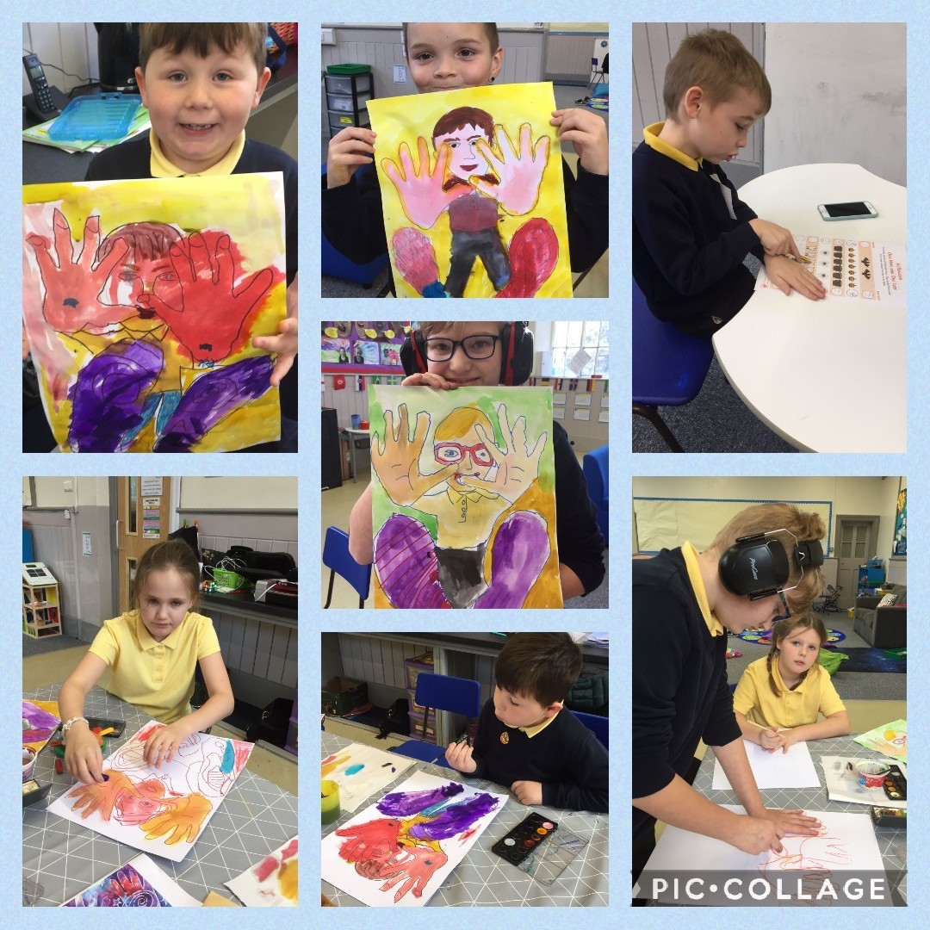
Admissions and Transfers
Admission’
The entry of children into schools is controlled and administered by an ‘Admissions Authority’ which in the case of Bodringallt Primary School is Rhondda Cynon Taf County Borough Council. Each parent/carer is asked to complete a form to apply for a place at school. The form needs to be accompanied by a proof of address. It is important to register an interest with the Headteacher prior to your child starting school so that we can ensure that you get the appropriate forms at the correct time. Applications to the school for admissions need to be made at the following stages of your child's education:
Pre-nursery
Nursery
Reception
Primary/ Secondary School transfer
If the number of preferences received for a school is above the school’s Admission Number the following over subscription criteria will be applied, in the priority order listed, to determine the allocation of available places:
Priority Category 1:
Children in public care (looked after children)
Priority Category 2:
Children who live inside the school’s catchment area who have an older sibling attending the school from the same address, at the date of the application, who will continue to attend that school the following September.
Priority Category 3:
Children who live inside the catchment area who do not have an older sibling attending the school

Slide 11
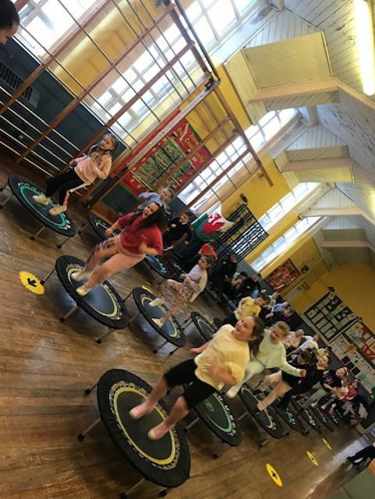
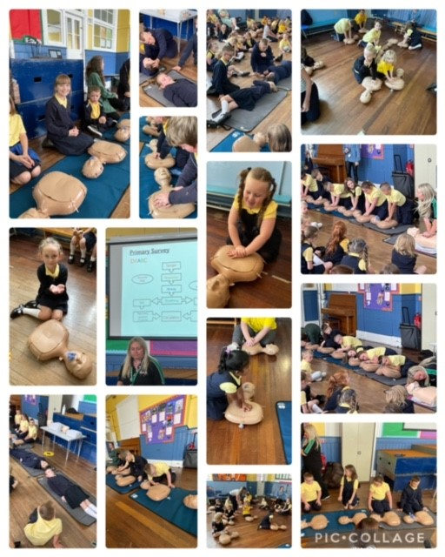
Admissions and Transfers
Priority Category 4:
Children who live outside the school’s catchment area who have an older sibling attending the school from the same address, at the date of the application, who will continue to attend that school the following September.
Priority Category 5:
Children who live outside the school’s catchment area who do not have an older sibling attending the school.
Further details about the school admission and transfers can be found in the starting school booklet on the link below
Http://www.rctcbc.gov.uk/en/educationlearning/schoolscolleges/schooolplaces-admissions/schooladmissionsinformationandadvice.aspx
Transfer to Secondary Schools
At the end of year 6, pupils may apply to enter their secondary school. The majority of our pupils transfer to Treorchy Comprehensive School. This transition is eased by frequent visits from Comprehensive School staff and pupils attend a series of transition days with the Treorchy Cluster Schools. For those attending elsewhere, we support the transition by undertaking steps as previously stated.

Slide 12
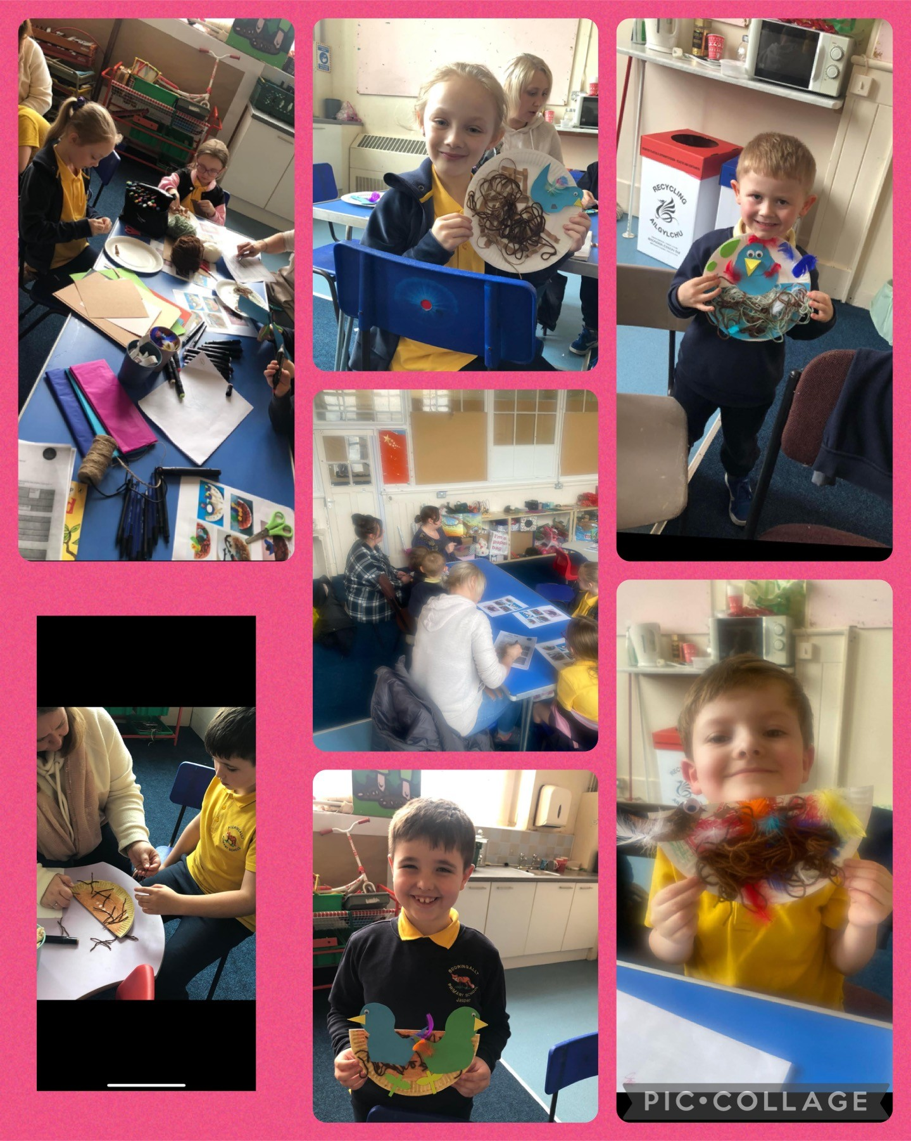
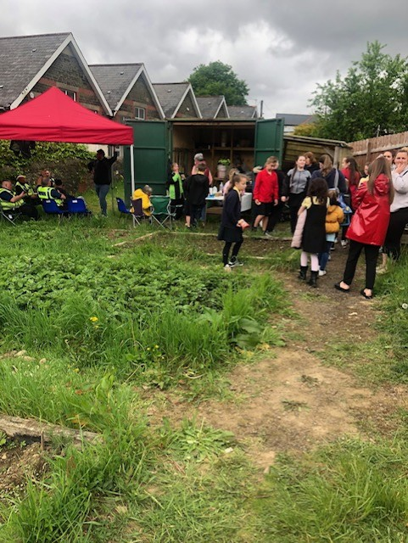
Home- School Agreement + Consents
In accordance with guidelines of the LA our school agreement is an integral part of our whole school approach to partnership with parents.
It is our belief that children achieve more when home and school work together and parents help more effectively when they know what the school is trying to achieve and how they can help.
Every school is required to produce a home school agreement which outlines the commitment that both parties make to each other in ensuring a quality education for the children, in other words…
The school's responsibility to its pupils.
The responsibility of the pupils' parents / carers.
What the school expects of its pupils and parents/carers.
A copy of the Home- School Agreement, along with a detailed consents form will be provided for parents to sign when they first admit their child to school.

Slide 13
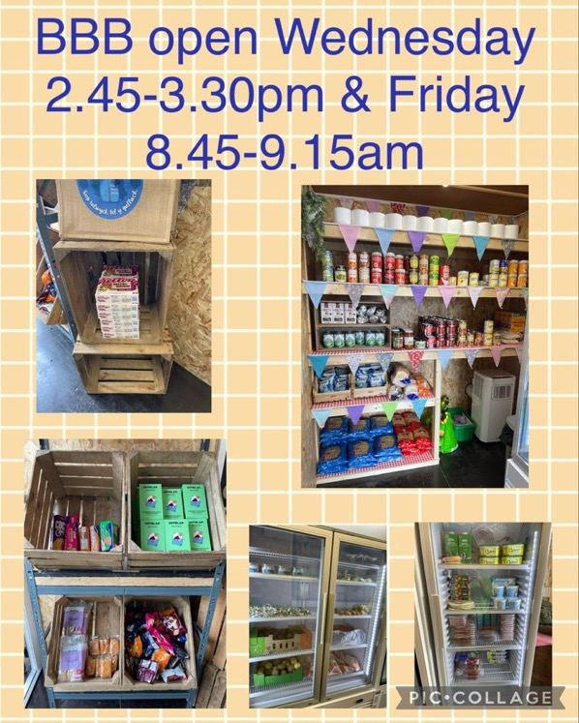
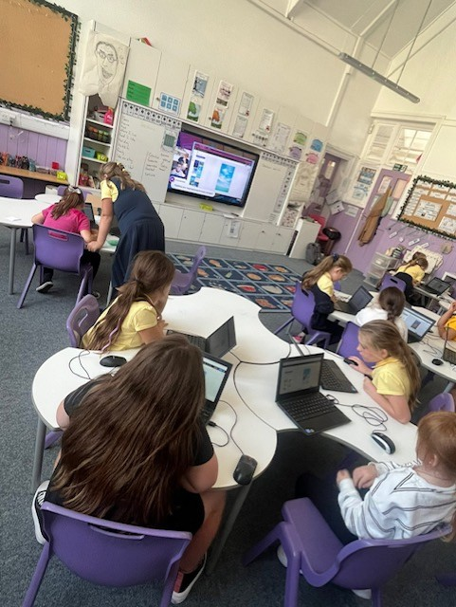
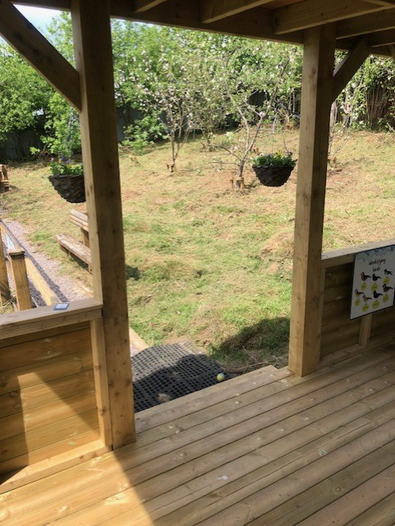
Facilities at our School
Every classroom is age appropriate and fosters independent learning / collaboration supporting and enhancing learning.
We, with our partners have worked extremely hard and are very proud of the learning environment we have developed in line with research and pupil voice.
You will see learning using natural materials such as loose parts, and wood to encourage curiosity, provoking creative choices and open-ended play.
The classroom environments are child-centred and you will see settees, children working on the floor, individually at a table, on high tables and stools or in small groups.
Over the last few years the school has worked tirelessly to ensure it is fit for 21st century learning – providing flexible and responsive adaptations to the ever changing needs of our cohorts / learners.
Currently the school has:
‘Rainbow Class’ – providing the ‘extra’ to our learners sitting above our universal provision
‘Bod Pod’ – break out area for learners to learn or self regulate
Family Room – Family engagement + learning activities
A ‘Big Bocs Bwyd’ – pay as you feel food shop for our community – run by volunteers – open twice weekly
A Family Engagement Officer – Mrs Howells – here to help families and runs our longstanding Rainbow provision + delivers interventions too
School Garden + Outdoor Classroom
Ipads / laptops in every classroom
Enhanced technology in classes
Interactive screens in every class
Breakout learning areas

Slide 14
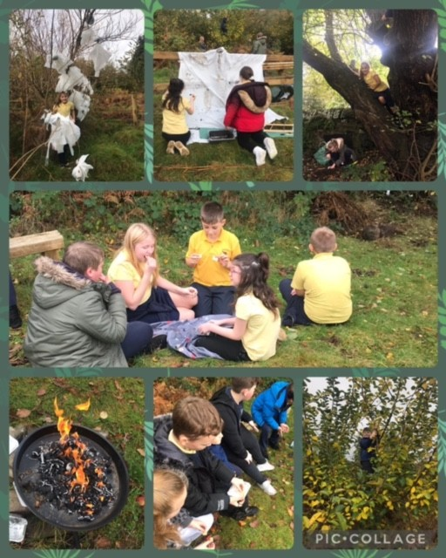
Learning and the Curriculum
Bodringallt Primary is committed to creating and delivering a curriculum accessible to all based on three aspects of curriculum design: the “Why, How and What”.
WHY? As a school we have developed a curriculum that offers children a voice in the planning to ensure that our learners are fully engaged to develop responsibility and independence.
HOW? We offer our learners a mix of discrete and inquiry-based teaching and learning that starts by getting our pupils to pose questions and engages our pupils by making real life connections.
WHAT? Our curriculum is based on the four purposes. Our curriculum is designed to ensure our children are:
Ambitious Capable Learners
Enterprising Creative Contributors
Ethical Informed Citizens
Healthy Confident Individuals
Bodringallt Primary also ensures that our learners have a curriculum that is progressive and one in which they will experience equal weighting of the 6 Areas of Learning and Experiences (AoLES).
Our curriculum is based around progression coverage and development of the 27 What Matters Statements within these Areas of Learning and Experience. Assessment is then used to drive attainment in these areas for individuals and groups of learners.
We pride ourselves on the high standards achieved here, across the curriculum. This is verified by the quality of the children’s work, by their attitude and by their achievements. To achieve this we rely upon close co-operation between home and school.
The role of assessment in Bodringallt is to support individuals on an ongoing, day-to day basis, identify, capture and reflect on individual learners' progress over time and to deepen understanding on group progress to reflect and refine practice.
Further detail on the Currciculum for Wales follows; the Progression Steps (replacing key stages) and the Areas of Learning Experiences (AoLES) replacing the National Curriculum.
As we continue to design, implement and review our curriculum we will be asking for community involvement and views. There will be opportunities for you to attend meetings, provide feedback via online forms or evaluations to complete. Please take the time to complete or attend as these will help us ensure we continue to develop and improve our Curriculum here at Bodringallt. Diolch.

Slide 15
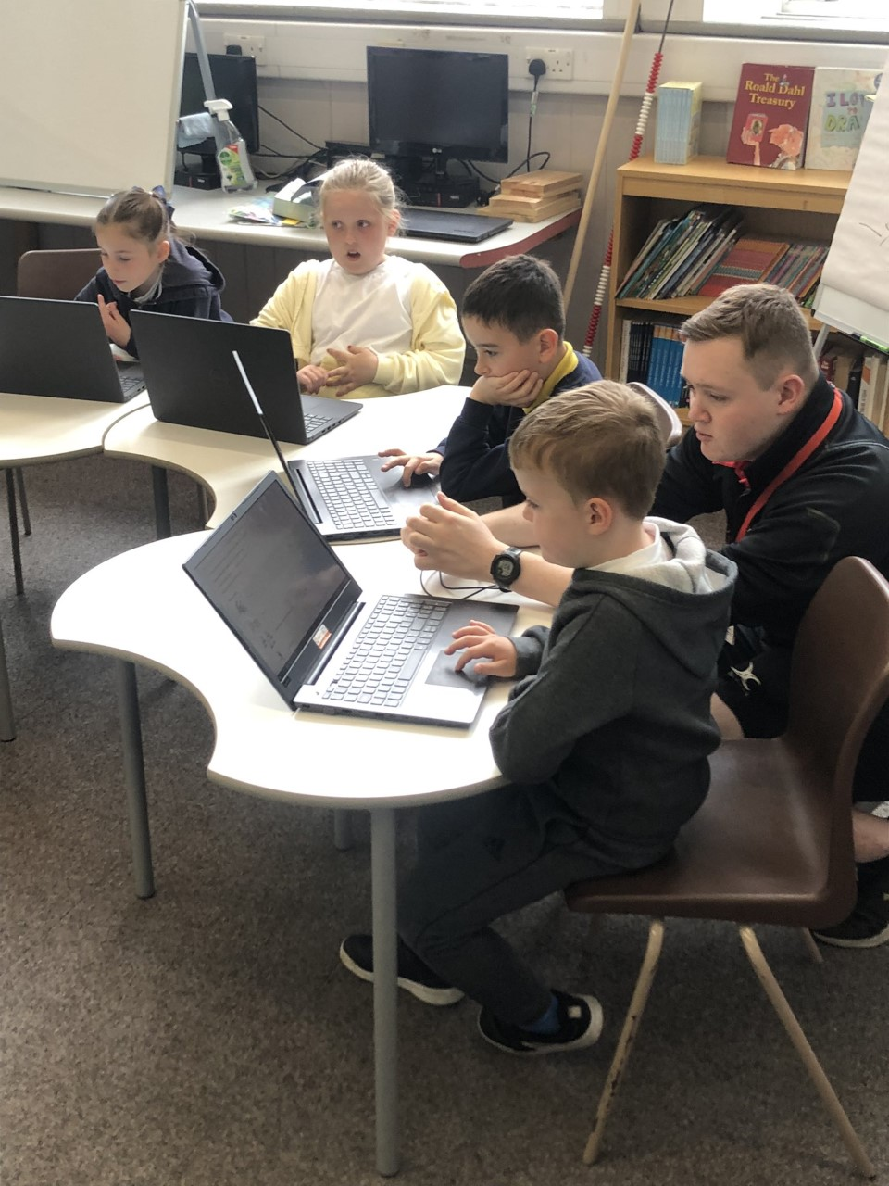
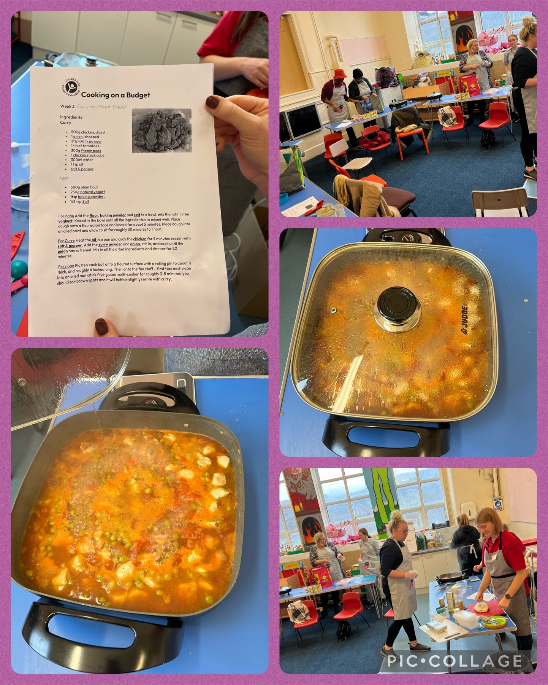
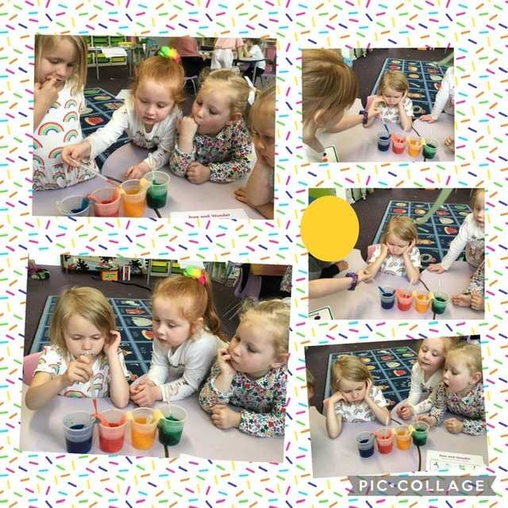
Learning and the Curriculum
Progression step 1
The Foundation Phase is vitally important, as it lays strong foundations for further development. Parents/carers play a particularly important part at this stage of their child’s education, and strong partnerships and communication are encouraged between school and home. The focus within this progression step is to develop a feeling of Cynefin (belonging) to our school, family and community and this is then further developed throughout the school.
A strong emphasis is placed at this stage on the acquisition of language skills and personal and social skills. All nursery pupils are able to access the curriculum for funded non-maintained nursery settings. Reception children access Curriculum for Wales.
Progression step 2 and 3
All subjects are taught through inquiries (topics) and literacy, numeracy and digital Competency skills are developed discreetly and through the inquiries. The development of ICT skills is important, so pupils can use these skills effectively to support their learning across the curriculum.
Discrete teaching
Discrete teaching is stand alone learning or the teaching of skills. In our school this is often the teaching of the skills of English and Maths, Welsh and an additional language, RE, PE , ICT and any aspect of the curriculum at the teacher’s discretion.
Inquiry Based Learning
Inquiry based learning is a mixture of directed, facilitated and independent learning that starts with a question or statement. This question or statement takes the learner on a learning journey that can be part directed by the teacher and part self-directed by the learner.

Slide 16
Learning and the Curriculum
We are working towards our ‘Healthy Schools’ accreditation. In progression steps 1,2 and 3 we provide our children with a daily healthy snacks and we ask families to support this by paying £1 per week. Children in Nursery, Reception, Year 1 and Year 2 will receive free milk during snack time. Any left over milk is given to the children to take home at the end of the day. Snacks are also offered to pupils in Dosbarth Gwdihw, Wiwer and Llwynog. They also can donate £1 per week towards fruit snacks.
Pupils are encouraged to bring healthy snacks to school. As we are a healthy school we ask that no chocolates, sweets or crisps are eaten during break times. Fizzy drinks are also not permitted. Research has shown that children’s concentration is improved if they drink water regularly. Therefore, we encourage pupils to bring bottles to school so that they can be filled.
At our school there is a full programme of extra-curricular activities and pupils are encouraged to participate in this important part of school life. The aim is to build confidence by allowing pupils to have new experiences and also to take on leadership roles.
Extra Curricular / Enrichment / Community Activities we offer are:
Cambrian Multisports Club Y2 -6 | Cricket | Rugby | Breakfast Club | Big Bocs Bwyd
Fun Club Y1+2 | Golf | Football | Coding Club | Cluster Sports
Residentials | Dance | Swimming | Senedd | Choirs – School and Côr Clwster
Pantomine | Trips | Visits | Walks | Performances

Slide 17
bb
Learning and the Curriculum
At Bodringallt Primary School we offer a curriculum which is broad, balanced, relevant and differentiated.
Great emphasis is placed on providing a wide and balanced curriculum and at Bodringallt Primary, it is our aim to provide our children with much more than the Curriculum for Wales. Through our commitment for the personal and social development of our children we endeavor to provide a ‘holistic’ education, which will be of lasting value to our children for the rest of their lives.
The curriculum for Wales is mandatory in schools as of September 2022. Over the last five years we have been working with all stakeholders (parents, governors, pupils, staff, Consortia, Curriculum specialists, professional networking and self directed research along with schools within and beyond our cluster to create, evaluate and develop a bespoke curriculum that is designed to suit the needs of all our learners here and one that will help them achieve their full potential. Our curriculum, will continue to be monitored, evaluated and improved throughout the next academic year.
As well as literacy, numeracy and digital skills, there are six areas of learning and experience. Everything your child learns will be connected to these areas.
Expressive Arts
Humanities
Mathematics and Numeracy
Languages, Literacy and Communication
Health and Wellbeing
Science and Technology
In Expressive Arts they will explore art, dance, drama, film and digital media and music to develop their creative, artistic and performance skills.
In Humanities they'll learn about the world, society and events in the past and present. They will explore the challenges and opportunities that face us, and what ethical action we can take to safeguard the world and its people in the future.
In Mathematics and Numeracy they will develop their understanding of numbers and use symbols in Maths. They will explore shapes and measurement and learn about statistics and probability.

Slide 18
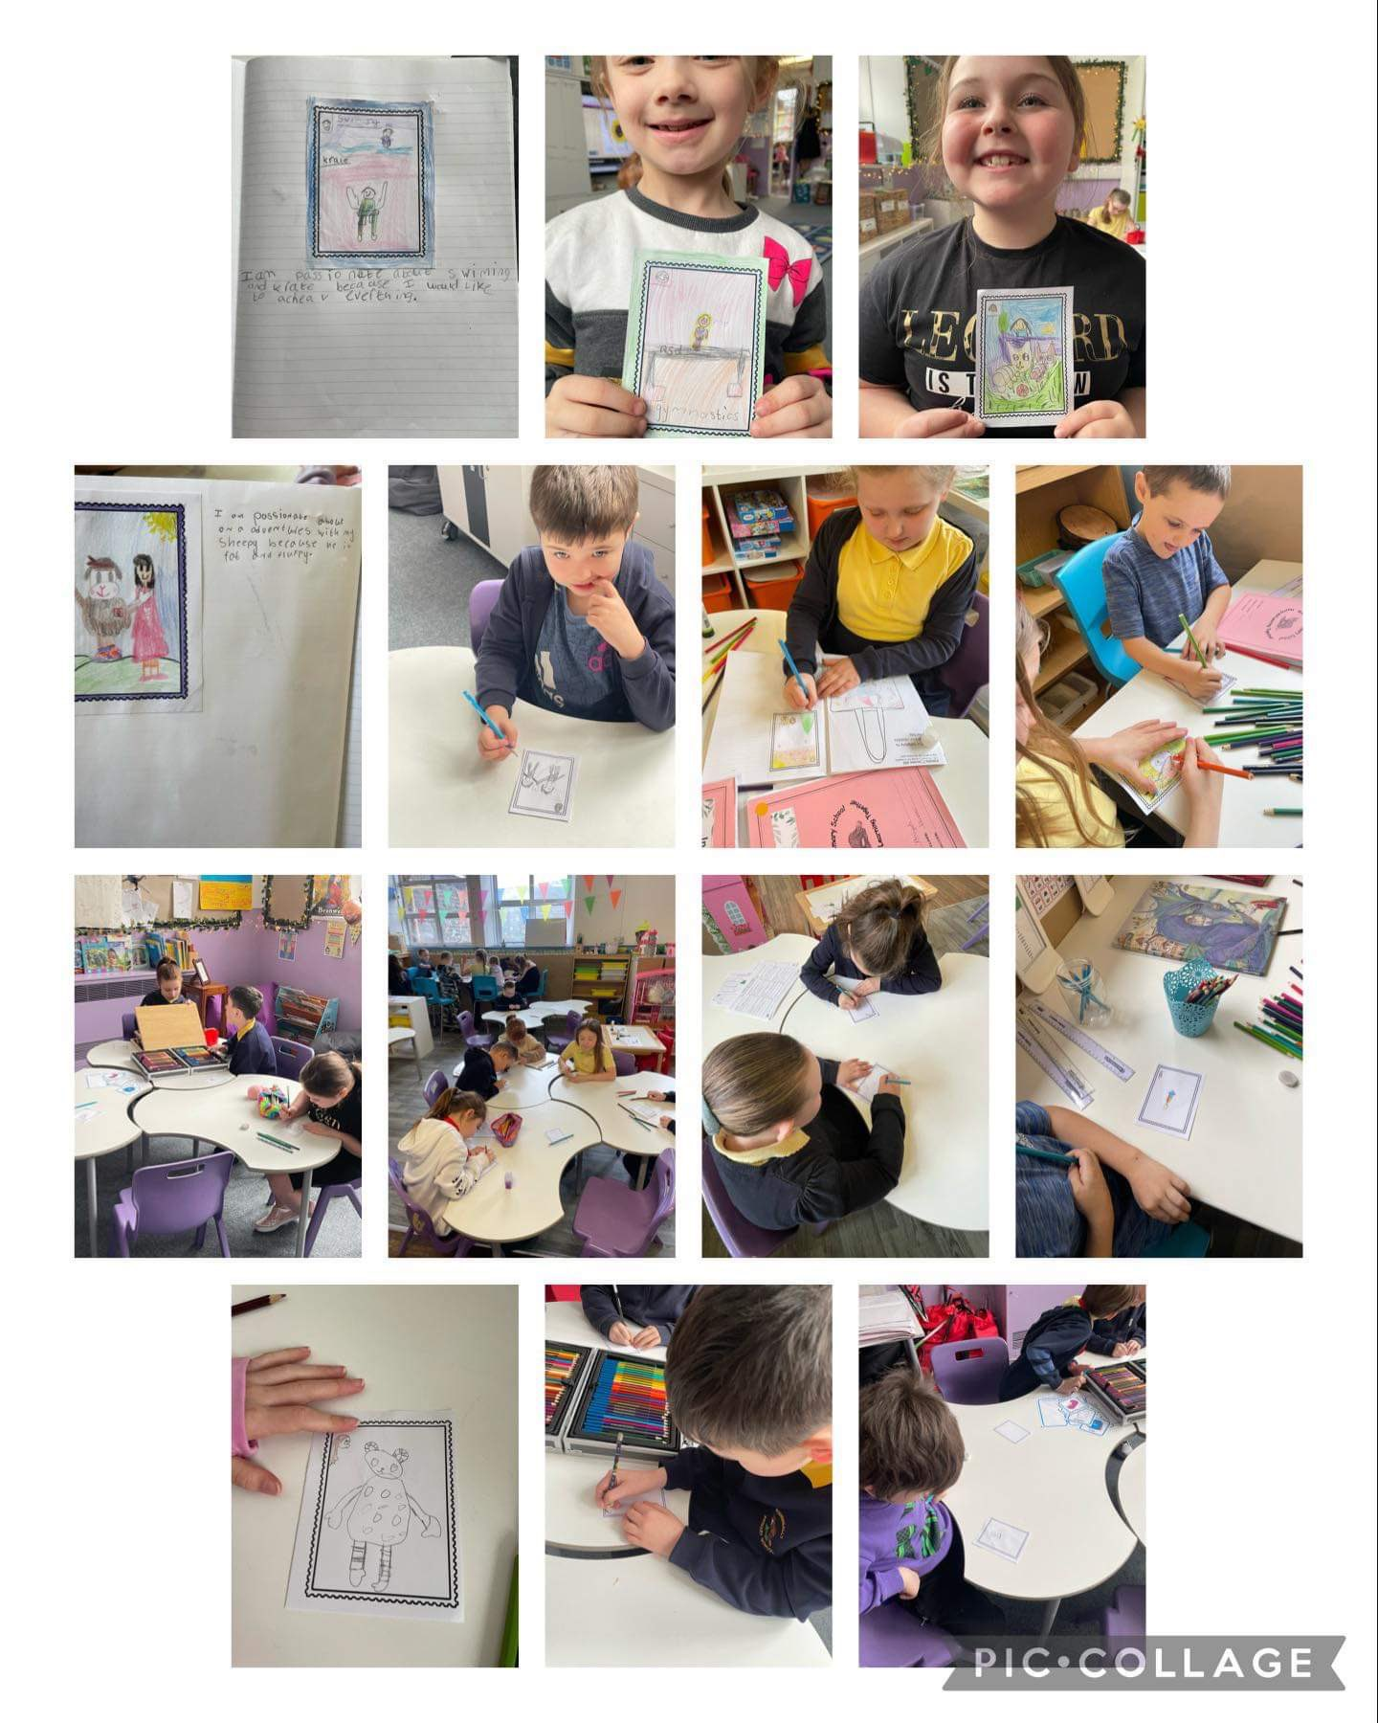
Learning and the Curriculum
Health and Wellbeing is about looking after their physical and mental health including emotional wellbeing. They will learn about healthy eating and how to make good decisions, deal with influences and develop healthy relationships.
In Languages, Literacy and Communication, they will learn about languages. They will understand and use Welsh, English and other languages (Spanish and British Sign Language). They will study and create literature, and communicate in spoken, written or visual ways. This could include poetry, drama and film.
In Science and Technology your child will learn about biology, chemistry, physics, computer science and design technology. They will learn about design and engineering, living things, matter, forces and energy, and how computers work.
The curriculum also covers:​
Human rights​
Diversity and respecting differences​
Experiences and skills for careers and the workplace​
Learning about local, national and international contexts​
Developmentally appropriate relationships and sexuality education​
The new curriculum develops your child's knowledge, skills and experiences.
Learning in a way that works for your child
Learning is not always linked to their age. It will not happen in the same way, or at the same time for everyone.

Slide 19
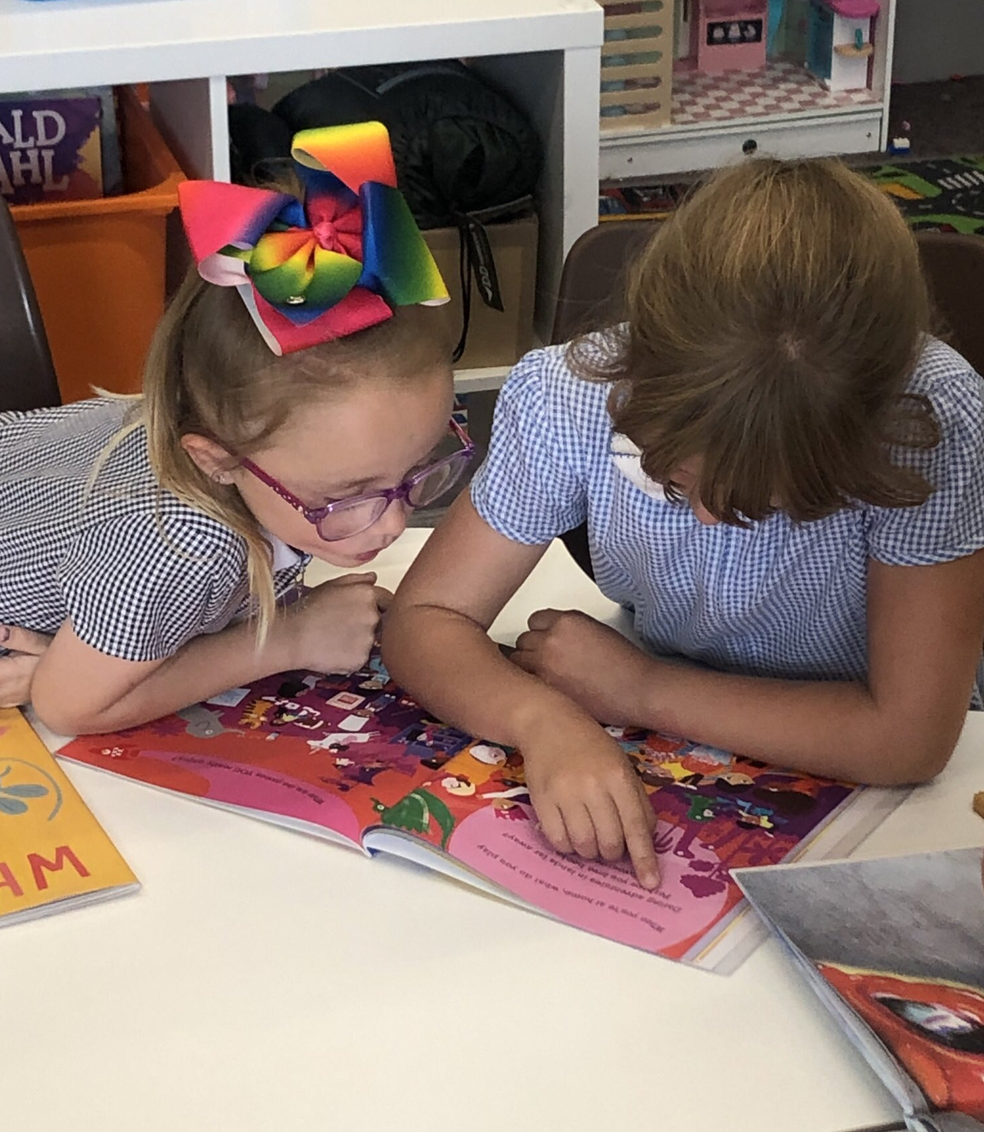
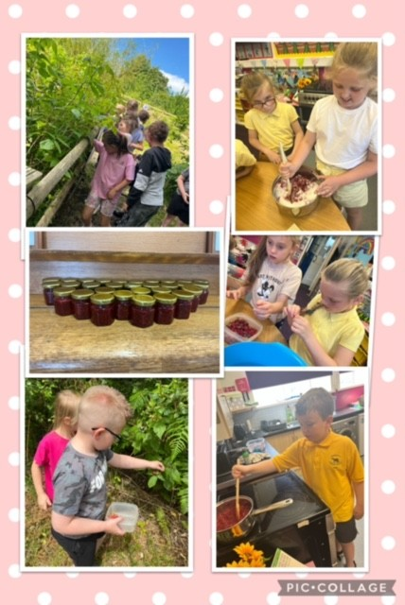
Learning and the Curriculum
At Bodringallt Primary School, a variety of teaching methods are used, and at various times during the week, children are taught:
As a class
As a group, using an integrated approach to several areas of the curriculum.
As individuals, where instruction is given on a one to one basis
Within each class the children are supported by a flexible and responsive provision, depending on their needs, context, task or what is being learned - ranging from ability, needs, to friendship groups. Learning is matched to the ability of the individual child. This allows children to make good progress at their own level.
The curriculum in Bodringallt Primary School aims to reflect the ambitious and aspirational nature of the vision of Curriculum for Wales.
Our focus is on the progression of learning

Slide 20

Learning and the Curriculum
Welsh/Cymraeg
We have recently been awarded ‘Siarter Iaith Bronze Award’. Welsh is used incidentally, greetings, instructions etc and is taught throughout the school, providing progression for children developing Welsh as a second language. Welsh is structured to allow children to speak it as much as possible, to provide our pupils with the idea that Welsh is a living language. Our ‘Criw Cymraeg’ promote this very actively too – with pupils issuing ‘Tocyn Iaith’s’ to those using patterns/words of the week launched in weekly assembly. We actively promote an awareness and pride in Welsh culture/heritage throughout the curriculum – our Eisteddfod being one of them.
Religious Values and Ethics (RVE)
RVE is a statutory requirement in the Curriculum for Wales for all learners from age 3 to 16 – we will be following an agreed syllabus – link below
https://www.rctcbc.gov.uk/EN/Resident/SchoolsandLearning/RelatedDocuments/Religionvaluesandethics/AgreedSyllabusForReligionValuesAndEthicsRve.pdf
Search for meaning and purpose
How people respond to the deeper questions of life in order to understand the human condition.
The natural world and living things
How and why people show concern and responsibility for the world and experience awe and wonder in nature.
Identity and belonging
What makes us who we are as people, communities and citizens living in a diverse world.
Authority and influence
How and why different types of authority influence people’s lives.
Relationships and responsibility
How people live together, and why developing healthy relationships is important.
Values and ethics
How and why people make moral choices and how this influences their actions.
The journey of life
What people experience as part of the journey of life, and how these experiences are acknowledged
Relationships and Sexuality Education - RSE (RSE CODE)
RSE is a positive and protective part of the Curriculum for Wales.
It plays a central role in supporting learners’ rights to enjoy fulfilling, healthy and safe relationships throughout their lives.
The RSE curriculum will be developmentally appropriate for children in Bodringallt Primary.

Slide 21
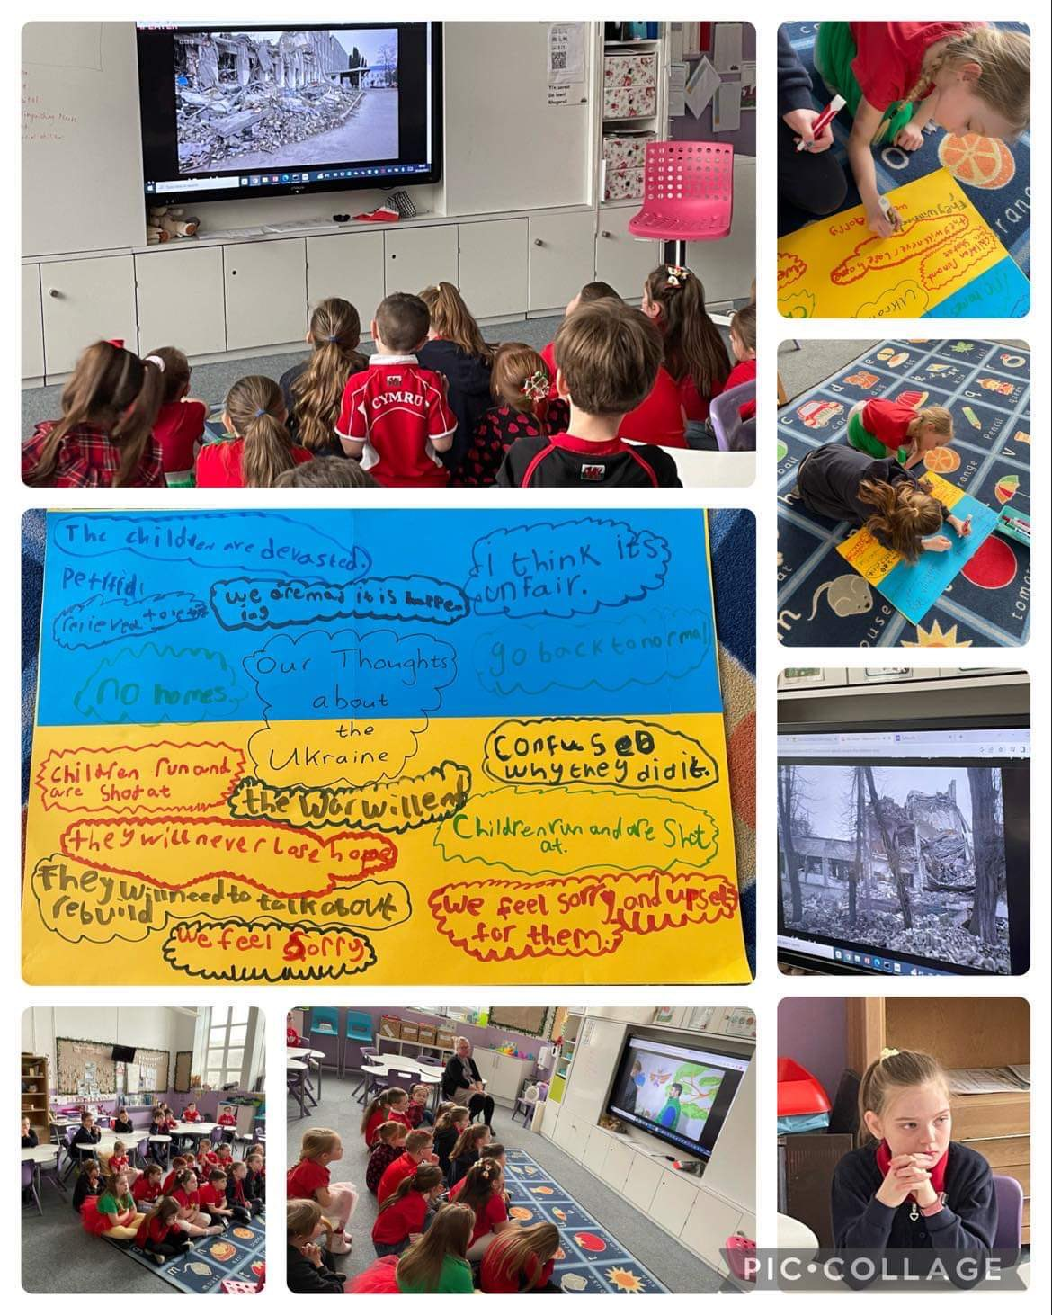
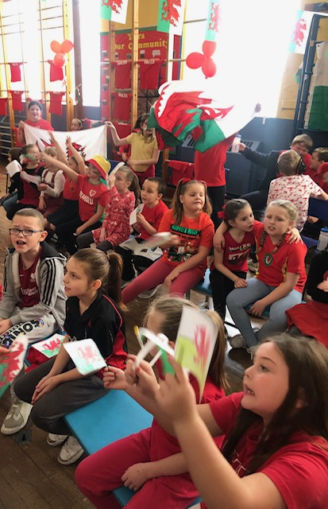
Learning and the Curriculum
Developmentally appropriate Relationships and Sexuality Education (RSE)
During their time with us in Bodringallt Primary, children will learn:
Developing empathy and kindness through positive interactions.
Promoting awareness that there are different types of families and relationships- and everyone is unique.
Learning how human beings change as they grow.
Recognising the importance of looking after yourself and personal hygiene.
Learning the right words for body parts.
Knowing the benefits of asking for help and who to ask for help.
Realising that everyone has a right to privacy and to understand the general idea of consent in everyday dealings with others.
Being able to interact with others in a way that is fair and respectful to all.
This will be critical to building a society which treats others with understanding and empathy, whatever their ethnicity, social economic background, disability, sex, gender or sexuality.
By the end of year 6, in line with what currently happens, most learners would have learned about reproduction. This will be handled appropriately, sensitively and only when learners are ready.

Slide 22
Extra Curricular / Enrichment / Community Activities
A number of extra- curricular activities are available to the children, despite funding cuts, leading to staffing reductions and increasing costs for providers. We are always seeking providers / funding to provide no cost clubs. These vary from term to term and are often based upon what is affordable, available and most suitable at that particular time of the year. The aim is to build confidence through new experiences and develop leadership roles. At various times we are able to offer the following.
School Senedd
The Senedd is a committee of pupils who have been elected by their peers. As we are a very small school, the Senedd incorporates ECO, Healthy Schools, JRSOs roles too. It gives the pupils a ‘voice’ to make changes in our school, such as our school garden and outdoor classroom, healthy eating and improving play equipment.
Criw Cymraeg
The Criw Cymraeg are encouraged the use of the Welsh language throughout the school in addition to promoting a positive Welsh ethos. All of their hard work will go towards helping us achieve the Cymraeg Campus language charter silver award.
Healthy Schools
We are working towards our ‘Healthy Schools’ accreditation. In progression steps 1,2 and 3 we provide our children with a daily healthy snacks asking families to support this by paying £1 per week. Children in Nursery, Reception, Year 1 and Year 2 will receive free milk during snack time. Any left over milk is given to the children to take home at the end of the day. Snacks are also offered to pupils in Dosbarth Gwdihw, Wiwer and Llwynog. They also can donate £1 per week towards fruit snacks.
Pupils are encouraged to bring healthy snacks to school. As we are a healthy school we ask that no chocolates, sweets or crisps are eaten during break times. Fizzy drinks are also not permitted. Research has shown that children’s concentration is improved if they drink water regularly.
Friends of Bodringallt Primary
A friends group was revived in September 2023, this group aim to engage the community; organising events/fundraisersfor extra equipment/resources and towards enrichment. We, as a school, appreciate the incredible communal role they play in bringing our community together at various times of the year. If you would like to find out more about the group or support our school by becoming a member please let us know.
Cambrian Multisports Club Y2 -6 | Cricket | Rugby | Breakfast Club | Big Bocs Bwyd
Fun Club Y1+2 | Golf | Football | Coding Club | Cluster Sports
Residentials | Dance | Swimming | Senedd | Choirs – School and Côr Clwster
Pantomine | Trips | Visits | Walks | Criw Cymraeg

Slide 23
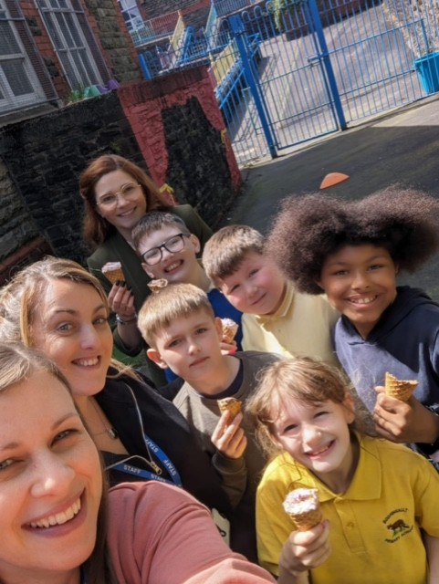
Additional Learning Needs
The ALNCo supports staff to identify any additional learning needs that may be a barrier to learning. A pupil centred meeting will take place to discuss these barriers and an appropriate support plan will be put into place. This could be in the form of adjusted provision or an individual educational plan. Please contact us. Also more information via RCT link - www.rctcbc.gov.uk
LA Designated Class for Social Emotional and Behavioural Difficulties (SEBD) Dosbarth Llwynog
We have a LA Designated Class (Dosbarth Llwynog) for Social, Emotional and Behavioural Difficulties (SEBD) in Bodringallt Primary School, which caters for children aged between 7-11 years old. The pupils are allocated places here by the LA.
This class caters for pupils who find it difficult to cope in a large classroom settings and may have many other associative difficulties e.g. which have impacted on their education within a mainstream setting.
This class has three members of staff and up to eight children. These children are placed into this provision by the Local Authority.
The provision provides 4 days here and 1 day at their mainstream school (Mondays). The children are included and integrated into our mainstream provision, when they are ready /or it is appropriate for them; opportunity to join in all whole school activities and will attend their mainstream schools on Mondays. Here, they integrate with their mainstream classes for a variety of learning and enrichment activities, for play, dinnertimes, assemblies and events.

Slide 24
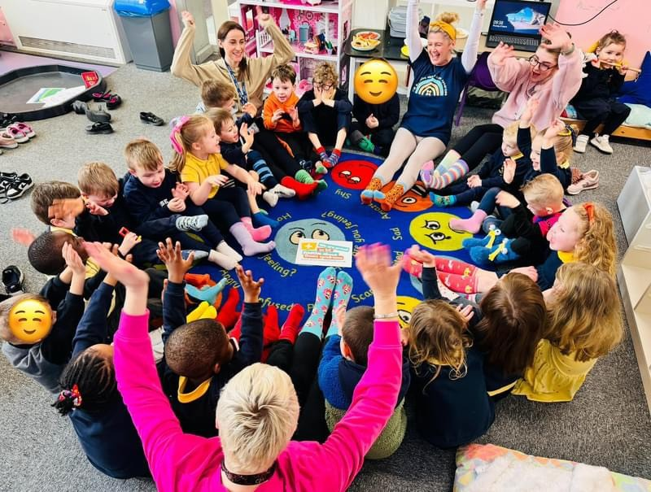
Health and Safety
The health and safety of all the children in our school are of utmost importance and have arrangements in place to safeguard and promote the welfare of all the children in our care. We recognise that high self-esteem, confidence, supportive friends and good lines of communication with a trusted adult helps to safeguard pupils. The school will therefore continue to maintain an ethos where children feel secure and encouraged to talk through daily/weekly check-ins and restorative approaches.
The school has a robust system of risk assessment in place such to ensure the security of your children such as an electric system to enter the school, locked gates and correct staff to child ratio but recognises the risks outside the school gates must be managed in partnership with good communication. Parents are requested to park responsibly and to avoid parking on the pavement or on the school grounds. Smoking / Pet dogs are not permitted on school grounds.
We have three Level 3 Safeguarding Officers. Our Safeguarding lead is the Headteacher, Mr S Howells. We have two further Safeguarding Leads: the Deputy Headteacher, Mrs E Gooch and Classteacher Mrs L Matthews. Mrs L Llewellyn and Mrs R Mellor are the governors responsible for Safeguarding.
At various stages through the school years, children will have their eyesight and hearing tested and a routine dental check is usually carried out. Any concerns raised during these routine checks will result in the offer of an appointment to the relative health department.
When a child enters our school for the first time parents will be asked to sign a Home/School Agreement and a GDPR permissions form also.
Equal Opportunities
Bodringallt Primary School is committed to equality of opportunity for all its pupils, regardless of sex, race, disability , religion or social class. We want all our pupils to achieve their full potential during their time with us. We believe that all pupils are of equal worth and we place equal value on the abilities, talents and skills of every individual in our charge.
We actively attempt to make all aspects of the school curriculum equally attractive to boys and girls.
(Equal Opportunities Policy available from Headteacher)

Slide 25
School Uniform
All children are expected to wear school uniform, which is:
School sweatshirt/ cardigan / hooded jumper
Yellow polo shirt/ shirt
Navy / black trousers or skirt- blue/yellow summer dress/ pinafore
School uniform can be purchased from ‘U Design’ or similar items from supermarkets.
We have a collection of used uniform, coats / jackets that are also available on request through our school.
The wearing of jewelry is not encouraged and should be kept to an absolute minimum. Hoop earrings should not be worn to school.
Please ensure that all items of clothing, including PE kit are clearly labeled with your child’s name.
PE Kit
Children must have the necessary PE kit to participate in lessons. The class teacher notifies parents of PE times. The kit for PE and games activities is:
A white T-shirt
Blue or black shorts/ jogging bottoms
Trainers.

Slide 26
Important Information
Pupil / School Safety
Each morning, at 9am entrance gates get locked. All entry points are staffed twice daily. Entry to and exit from the school is only possible through the main entrance during the school day. Entrance may be gained into school via an electronically operated system. All visitors must sign in, wear a visitors badge and agree to our safeguarding briefing. Visitors ID is requested and they are accompanied as appropriate.
Complaints Procedure
We value the good relations we enjoy with parents and the community. We understand that at times misunderstandings and conflicts may arise. It is the schools policy to resolve these misunderstandings as soon as possible. Parents should talk with their child’s class teacher about his/ her progress or any concerns they may have. They will be able to advise you, and if not, pass you onto someone who can.
If, for whatever reason you feel the class teacher is not the best person for the complaint then you are encouraged to speak to the Headteacher or the Deputy Headteacher in their absence.
If the complaint cannot be resolved then the school needs to receive a complaint in writing, setting out the details in full to the Headteacher. The Headteacher will then investigate the complaint and will offer parents a meeting to discuss the outcome of the investigation. If concerns remain unresolved, then the parent is advised to write to the Governing Body. We follow RCT Complaints Policy.
Absences and Illness
Parents are asked to inform/provide evidence to the school for absences by pupils e.g. medical appointments. A message must be left on the schools answer phone to explain a child’s absence. Please note that without an acceptable reason for non- attendance, all absences will be recorded as unauthorised.
Absences for holidays
All schools request an application for holidays in term time – currently, we will only authorise those where attendance is over 90% (maximum of 10 school days over the academic year). A holiday form must be requested from school. From September 2024, this will rise to 95%, ALL SCHOOLS in the Treorchy Cluster will only be authorising holidays of 10 school days maximum, where attendance has been 95%+.
Illness
Should your child become ill during the school day, we will need to contact you and ask that you ensure that your telephone numbers are UP TO DATE (safeguarding) and an emergency number for someone nearby who may be contacted. Minor accidents will be treated by a member of staff who are qualified First Aiders. All accidents are recorded in an accident book. In the event of a more serious accident, parents will be contacted.

Slide 27
Important Information
Medicine in School
If parents are requesting a member of staff to administer medication to their child, written consent must be given. Any medication brought into school should be clearly marked with the child’s name and handed into the office on arrival at school, where parents will be asked to sign a form giving consent and clearly stating the dosage and times for administration.
Asthmatic children who need to carry inhalers to be used in school will also need their parents to sign a form to allow them to do so. These will be kept in lockable cabinets within their classes.
Charging and remissions policy
During the school year, children will have the opportunity to go on educational visits to support their schoolwork. We are very mindful of the difficulties of family incomes, and no child would be barred because parents were unable to afford the cost but, unless enough voluntary contributions are received, school visits/residentials will have to be cancelled.
School dinners
Cooked meals are available at school each day at NO COST. Each day there is an option of 2 choices for a hot meal and a cold option served either as a baguette, sandwich or roll. We offer a two week menu of hot dishes, along with a daily salad bar, a roll/sandwich menu and a jacket potato option. Our meals include a dessert and a drink. All schools offer unlimited wholemeal bread and, in addition to the dessert of the day, we also offer a limited choice of frozen yogurt, cheese & crackers or fresh fruit daily. All children in Primary School are eligible for free school meals which is in line with the WG Universal free school meal provision.
Sport and Extra curricular activities
A carefully planned timetable of PE allows children to develop their skills in gymnastics, dance and games. PE is delivered each week by the class teacher. All children from Years 3- 6 have swimming lessons each year – compulsory as part of the curriculum.
Sports such as athletics, dodgeball, football, golf, rugby, cricket and netball are all played at our school and children have opportunities to participate in many cluster sports events.
Pupil Toilets
Our toilets are open and available to pupils throughout the day. While pupils can have access at break and lunchtimes if they need to, we ensure pupils have access at all times. All toilet areas have properly maintained supplies of warm and cold water, soap, hand drying facilities, provided at a convenient height.
Any issues arising during use of toilets that are highlighted by pupils are dealt with sensitively and promptly.
All children have regular access to drinking water throughout the school day.

Slide 28
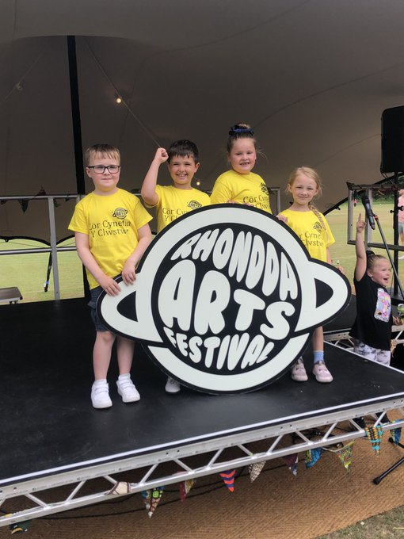
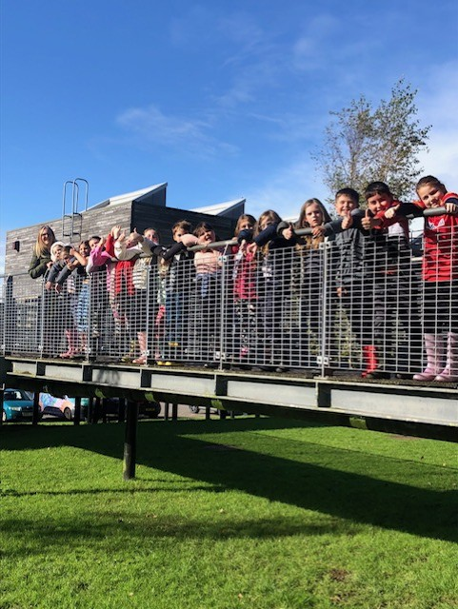
Keeping in Touch
The School Website:
www.bodringalltprimaryschool.co.uk
‘X’ (formerly Twitter) –
@bodprimary – information only
Facebook -
Bodringallt Primary School – information only
Teachers to Parents –
Text Service to parents/carers – information and reminders will be sent straight to your phone
Class Dojo / SeeSaw Apps –
This is where you will be able to receive information from class teachers and some will also send notifications through this.
Monthly Newsletters (paper based) with Diary – sent home with pupils
We always go above and beyond for our children, families and our community so the children can be the best they can be.
We believe you will love our beautiful school community.
Diolch.
Mr Howells and the Bodringallt Family.

